Slide 1
welcome

Slide 2
NovaCorp – Modern Web & IT Solutions
MD.SHAMSUL ALAM
0242220005101424
MARFI HASAN RAIHAN
0242220005101435
ARAFAT HOSSAIN
0242220005101415
SADID AHMED TURJO
0242220005101437
JUBAYER MAHMUD SHOYEB
0242220005101408

Slide 3

Introduction
NovaCorp represents a modern digital agency that provides complete technology solutions to clients. This project aims to transform NovaCorp’s service offerings into a visually stunning and easy-to-navigate website. By combining clean UI, responsive design, and interactive elements, the website delivers a professional online presence that reflects the company’s technological capabilities.

Slide 4
Problem Statement
Lack of a professional online presence for showcasing IT services.
No clear platform to display multiple service categories in a structured manner.
Poor user experience on older or non-responsive websites.
Difficulty for users to navigate and understand available services.
Weak branding due to inconsistent or outdated UI design.
Limited ability for the fictional company (NovaCorp) to attract potential clients

Slide 5
PROJECT OBJECTIVES
1
2
3
Develop a Modern and Responsive Website
Showcase Core IT Services
Improve User Experience (UX)
To design and build a visually appealing, mobile-friendly website that adapts seamlessly to all screen sizes
To present NovaCorp’s key services are a organized and user-friendly layout.
To create an intuitive navigation flow that allows visitors to easily explore services and access essential information.
4
5
Apply Real-World Web Development Skills
Implement Attractive UI/Visual Elements
To utilize HTML, CSS, JavaScript, and modern design techniques to simulate an industry-standard IT company website
To use professional graphics, icons, and color schemes that enhance the brand identity and improve engagement.

Slide 6


CORE TECHNOLOGIES: HTML & CSS
HTML: Page Structure Foundation
CSS: Styling & Layout Mastery
HTML is the backbone, meticulously organizing the content on each webpage. It defines headings, paragraphs, images, and links, forming the semantic structure of our site.
CSS transforms raw HTML into a visually stunning experience. It dictates colors, fonts, spacing, responsive layouts, and the overall aesthetic, ensuring a polished and engaging look.

Slide 7
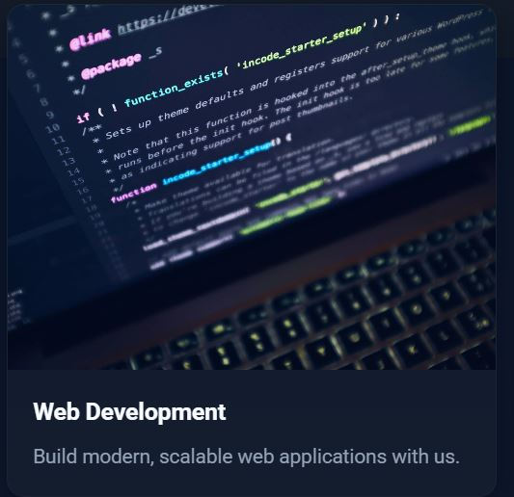




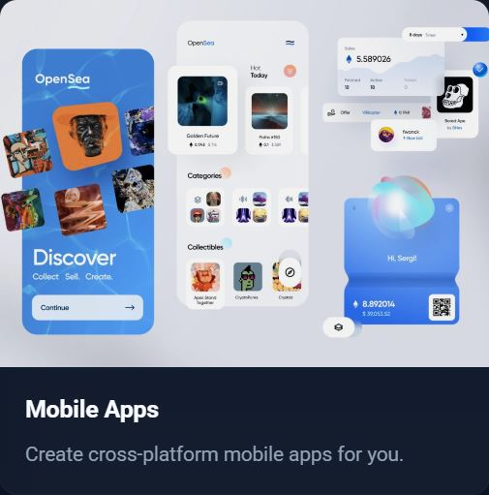
Key service

Slide 8
KEY FEATURES
1
2
3
Fully Responsive Design
Clean & Modern User Interface (UI
Intuitive Navigation Bar
The website automatically adjusts its layout across all screen sizes-desktop, tablet, and mobile-ensuring a seamless user experience.
A visually appealing layout with consistent spacing, color schemes, icons, and typography that enhances brand identity and user engagement.
A simple and structured navigation menu that allows users to quickly access Home, Services, About, Portfolio, and Contact pages.
4
5
Smooth User Experience (UX)
Fast Loading Performance
Optimized layout structure, proper alignment, and readable content make browsing simple and pleasant for users.
Lightweight design and optimized images ensure quick loading on both mobile and desktop devices.

Slide 9
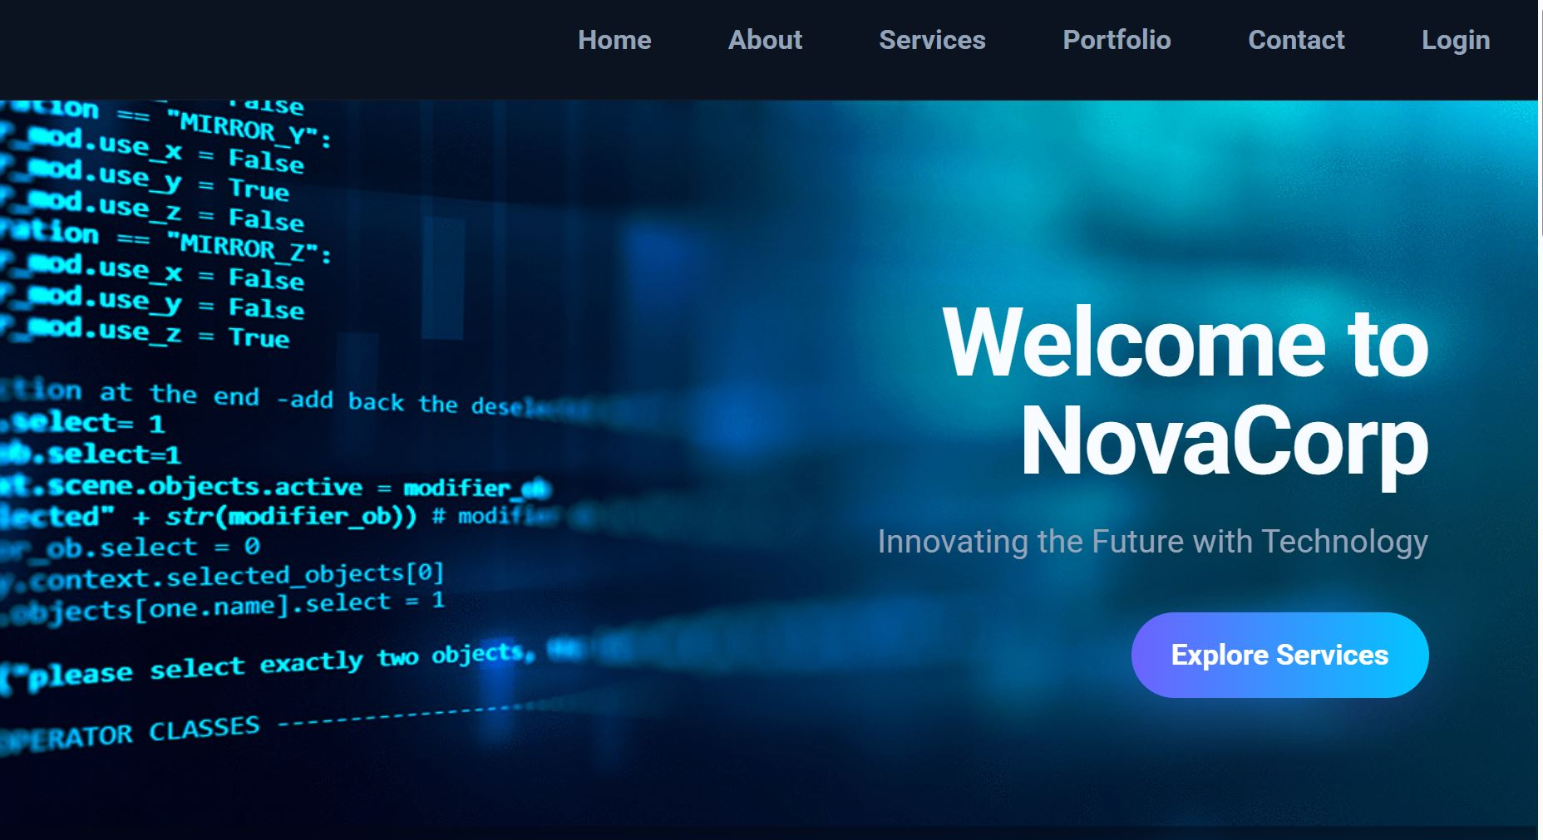
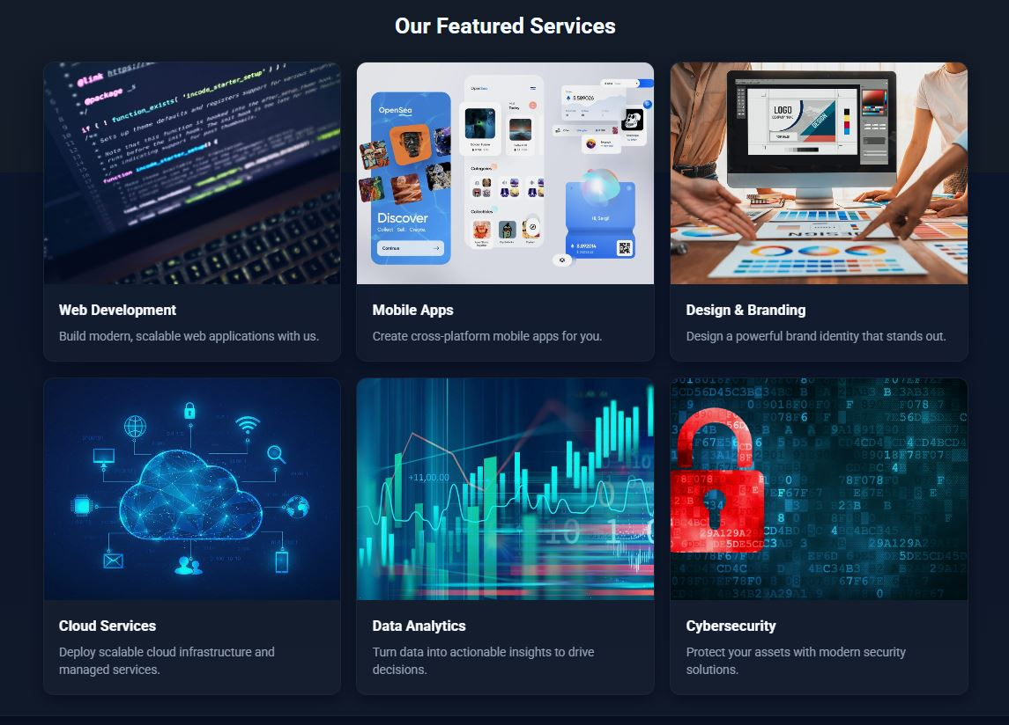
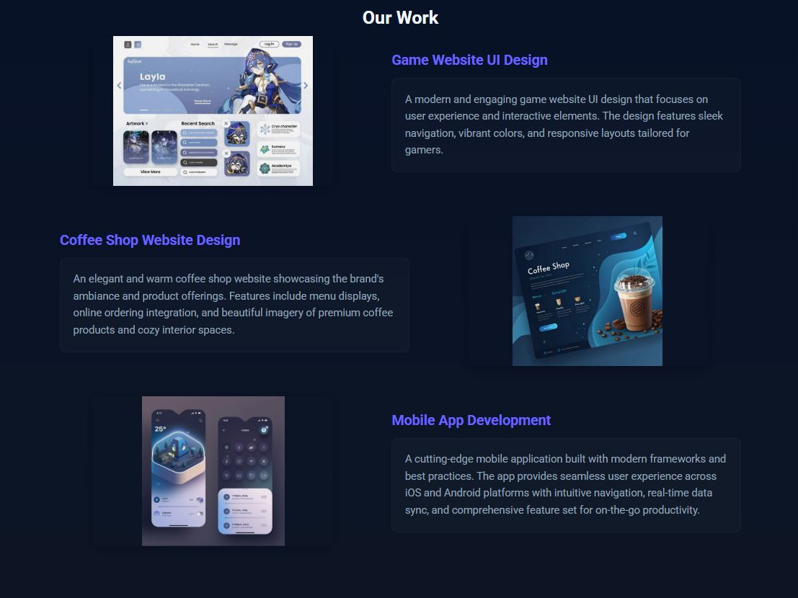
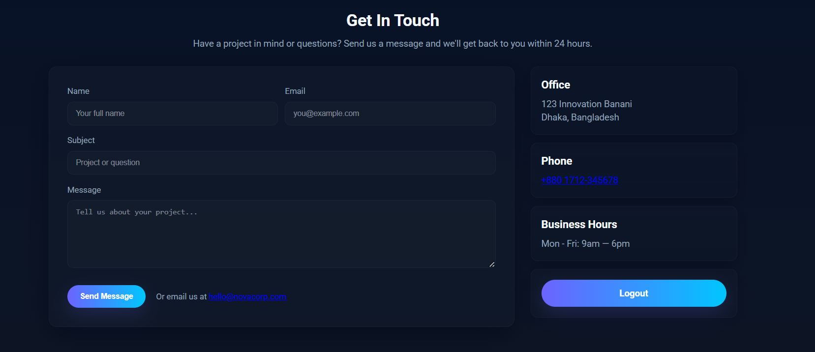
USER INTERFACE OVERVIEW

Slide 10
FUTURE ENHANCEMENTS
Add login/registration system
Admin dashboard for content update
Functional contact form with data storage
Modern UI enhancements (Dark mode + animations)
SEO implementation
Deploy to live server
Live chat or chatbot
Payment integration
SEO optimization

Slide 11
CONCLUSION
This project successfully delivers a clean, modern, and responsive website for NovaCorp that clearly showcases IT services and provides a smooth user experience. It demonstrates strong front-end development skills and follows professional UI/UX design principles. The website meets all project objectives and creates a solid foundation for future enhancements such as backend integration and dynamic features.

Slide 12
Thank you

